Slide 1


K.RAMAKRISHNAN COLLEGE OF TECHNOLOGY
(AUTONOMOUS), TRICHY.
DEPARTMENT OF
COMPUTER SCIENCE AND ENGINEERING
20CS5501 DESIGN PROJECT-1
Batch No. : 07
Date : 06.12.2024

Slide 2
AR IN EDUCATION USING ARCORE
Guided by Team
Mr. M SARAVANAN, M.E., Kavin Kirthik RP(811722104071)
Assistant Professor, CSE Kathirvel P (811722104070)
Nikhaal Ahamed A K (811722104101)

Slide 3
OBJECTIVE OF THE PROJECT
Enhance Student Engagement: To provide interactive, immersive experiences that capture students' attention and make learning more engaging and fun.
Support Visual Learning: To enable students to visualize complex concepts and abstract ideas through 3D models, simulations, and real-world overlays, improving understanding and retention.
Bridge Learning Gaps: To offer personalized learning experiences that cater to different learning styles and abilities, helping students who struggle with traditional methods.
Promote Active Learning: To foster hands-on learning by allowing students to interact with digital objects or environments, encouraging exploration and critical thinking.
Improve Retention and Recall: To enhance long-term memory retention by associating information with interactive, contextual, and spatially relevant elements.

Slide 4
ABSTRACT
Augmented Reality (AR) is revolutionizing the field of education by blending the physical and digital worlds to create immersive, interactive learning experiences. By overlaying digital content such as images, videos, and 3D models onto the real world, AR enhances traditional teaching methods, making learning more engaging and accessible. This technology supports visual, kinesthetic, and experiential learning, allowing students to explore complex concepts in ways that were previously impossible. AR fosters deeper understanding by providing hands-on experiences and real-time feedback, helping students retain information more effectively. It also promotes collaboration and creativity, encouraging students to engage in problem-solving and innovation. The adaptability of AR makes it suitable for diverse learning environments, from K-12 classrooms to higher education and remote learning scenarios. As AR continues to evolve, it holds the potential to transform education by offering personalized learning experiences.

Slide 5
LITERATURE SURVEY
TITLE OF THE PAPER | AUTHOR (S) | PUBLISHER | PAPER GIST | TECHNOLOGY USED
Augmented reality applications in education: A review of recent trends and challenges | S. Gupta, A. Sharma, and V. Kumar | IEEE Access | The paper discusses challenges like technical limitations, cost, and content design in AR education | Augmented Reality
Real-time markerless tracking for augmented reality on mobile devices | M. G. Jones, C. D. Lee, and L. H. Wang | IEEE Transactions on Multimedia | The paper explores real-time markerless tracking for AR on mobile devices, focusing on accuracy and speed. | Augmented Reality
Interactive augmented reality system for industrial assembly tasks | J. Zhang and L. Liu | IEEE Transactions on Industrial Informatics | The paper presents an AR system that aids industrial assembly with real-time guidance. | Augmented Reality

Slide 6
LITERATURE SURVEY
TITLE OF THE PAPER | AUTHOR (S) | PUBLISHER | PAPER GIST | TECHNOLOGY USED
Development of immersive AR environments for user experience evaluation in smart cities | A. Smith, R. Williams, and P. Thompson | IEEE Internet of Things Journal | The paper explores the development of immersive AR environments to evaluate user experience in smart cities. | Augmented Reality
Towards understanding object recognition in augmented reality environments | P. K. Agarwal, N. Patel, and S. Gupta | IEEE Transactions on Pattern Analysis and Machine Intelligence | The paper explores methods for accurate object recognition in AR environments. | Augmented Reality

Slide 7
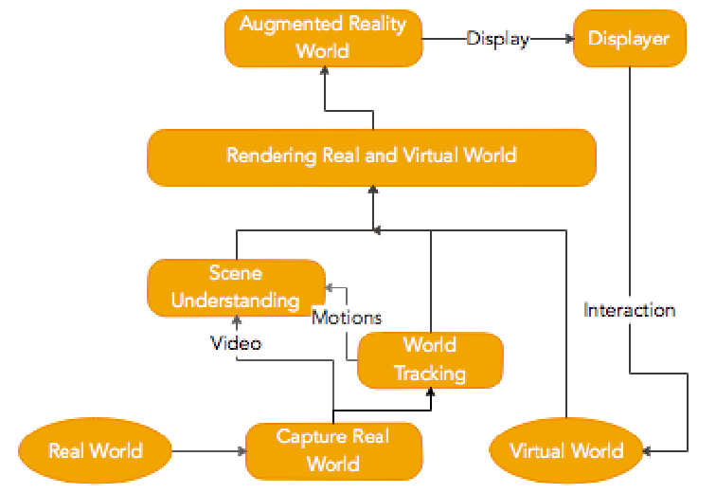
PROPOSED SYSTEM ARCHITECTURE

Slide 8
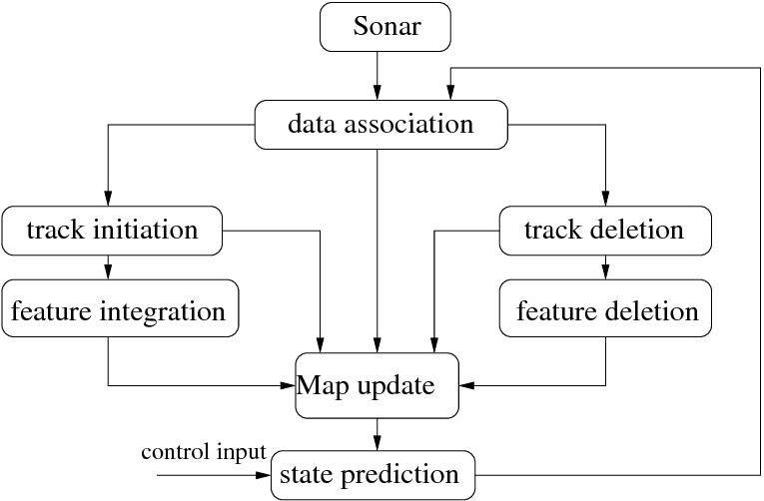
EXISTING SYSTEM ARCHITECTURE

Slide 9
SOFTWARE AND HARDWARE REQUIREMENTS
HARDWARE
SOFTWARE
IntelCore i7 13th gen
Nvidia rtx 3050
8gb ram
windows 10
unity
Blender
AR core
Visual Studio Code

Slide 10
MODULES
Main Menu
ARcore Implementation
Simulation
Chat Bot
NPC
Reward

Slide 11
SUMMARY OF MODULE-1
The Main Menu module is a vital part of an application, acting as the central hub for user interaction and navigation. It plays a key role in creating a gamified and engaging learning experience, which motivates users and encourages active participation.
As the primary point of access to all features, the main menu ensures easy and efficient navigation, reducing complexity and distractions. A well-designed User Interface (UI) is crucial to making navigation intuitive and user-friendly, enhancing both usability and aesthetic appeal.
This design encourages users to explore content, increasing engagement. Ultimately, a thoughtfully crafted main menu, combined with a compelling UI, is essential to the app's success, enhancing its educational value and user experience.

Slide 12
SUMMARY OF MODULE-2
ARCore is a software development kit (SDK) developed by Google to enable augmented reality (AR) experiences on Android devices.
It uses the device’s camera and motion sensors to overlay digital content onto the real world in real-time, creating immersive AR experiences. ARCore features include motion tracking, environmental understanding, and light estimation. Motion tracking uses the device's accelerometer and gyroscope to track movement, while environmental understanding allows for accurate placement of virtual objects on flat surfaces. Light estimation adjusts virtual content’s lighting to match the environment.

Slide 13
SUMMARY OF MODULE-3
Augmented Reality (AR) is revolutionizing modern education by providing immersive and interactive learning experiences that engage students more effectively. By integrating virtual elements with real-world environments, AR-based educational games allow students to visualize complex concepts, participate in hands-on learning, and retain information better. These games feature components such as immersive environments, gamification, real-time feedback, collaboration, and personalized learning paths. AR also enhances accessibility for diverse learners, offering practical, contextual learning that connects theoretical knowledge to real-world applications. Overall, AR-based educational simulations foster motivation, increase engagement, and improve retention, creating a dynamic and enjoyable learning experience.

Slide 14
SUMMARY OF MODULE-4
ChatBots are AI-driven tools designed to simulate human conversation and assist users through text or voice interactions. In educational apps, they act as virtual assistants, guiding users through app features, answering questions, and offering educational support. They help users navigate the app, provide step-by-step instructions, resolve technical issues, and offer personalized educational guidance based on learning progress. ChatBots also enhance gamified experiences, provide FAQs, and improve user engagement by sending reminders or new challenges. They can continuously learn and improve, offer multilingual support, and play a key role in boosting user retention.
The benefits of ChatBots include 24/7 availability, improved user experience, efficiency, scalability, and cost-effectiveness by reducing the need for human customer support.

Slide 15
SUMMARY OF MODULE-5
Interactive learning guides come to life with NPCs acting as virtual instructors, guiding users through lessons or tasks while offering real-time feedback, explanations, and hints to create a richer, more interactive learning environment. Additionally, NPCs enhance gamified learning experiences by setting challenges, assigning tasks, and rewarding users, motivating them through celebrations of achievements or guidance during failures. By driving the educational narrative, NPCs provide backstories or historical contexts that make learning immersive, adapting to users' decisions for a personalized experience. Furthermore, AR NPCs facilitate role-playing and practical simulations by recreating real-world scenarios, such as medical training or language practice, allowing users to engage in lifelike situations to hone their skills.

Slide 16
SUMMARY OF MODULE-6
Reward systems in educational apps play a crucial role in motivating users by combining intrinsic satisfaction from learning with extrinsic rewards such as badges, points, or other incentives. They encourage persistence, helping users overcome challenges and stay consistent in their learning journey. By reinforcing positive actions like completing lessons or tasks, these systems inspire users to maintain productive behaviors. Gamified features, such as leveling up, earning virtual rewards, and unlocking new stages, create an engaging and immersive experience that keeps users motivated and actively involved. Additionally, rewards serve as tangible indicators of progress, boosting users' confidence, fostering a sense of accomplishment, and encouraging them to pursue higher goals with renewed determination
.

Slide 17
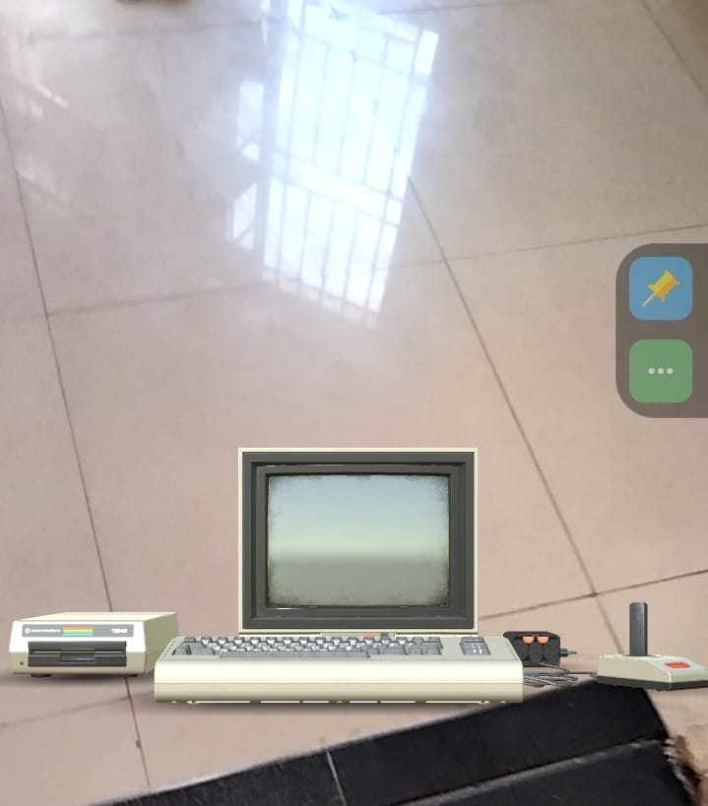
RESULTS AND DISCUSSION

Slide 18
CONCLUSION
Motivates Users: Reward systems combine intrinsic satisfaction from learning with extrinsic rewards like badges and points to encourage users to stay motivated.
Promotes Persistence: They help users overcome challenges and maintain consistency in their learning journey.
Reinforces Positive Actions: By rewarding tasks like lesson completion, these systems encourage productive behaviors.
Enhances Engagement: Gamified features like leveling up and earning virtual rewards create an immersive and engaging experience.
Boosts Confidence: Tangible progress indicators foster a sense of accomplishment and inspire users to aim for higher goals.

Slide 19
THANK YOU

